Slide 1
Behavioral Cloning To implement a self Drive car
Sriram Narra 200412751
Majid Alikhani 200408419

Slide 2
Content
Overview of self driving cars
Data acquirement
Preprocessing
Network structure
Network structure
Network structure-challenges
Network structure-final parameters
Results
Demo

Slide 3
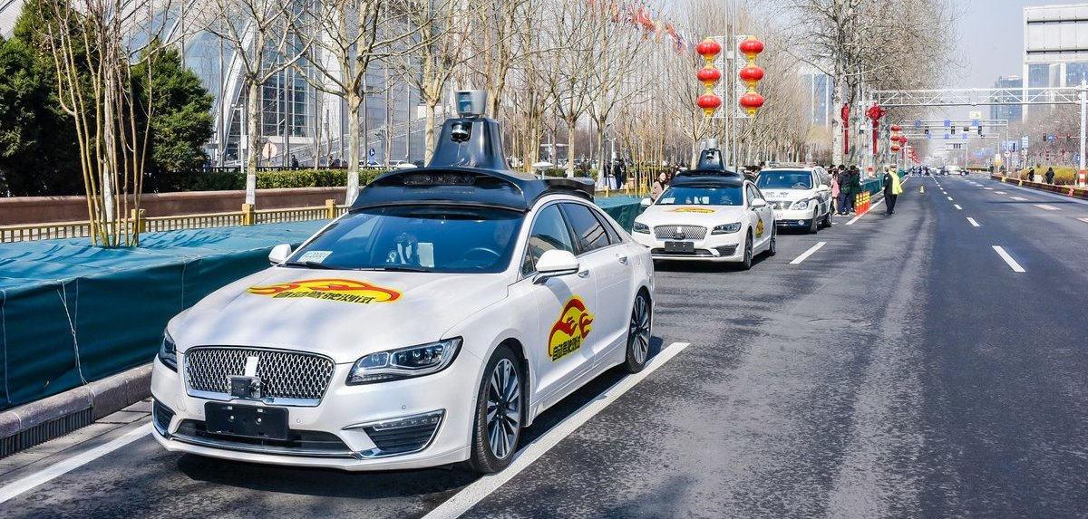
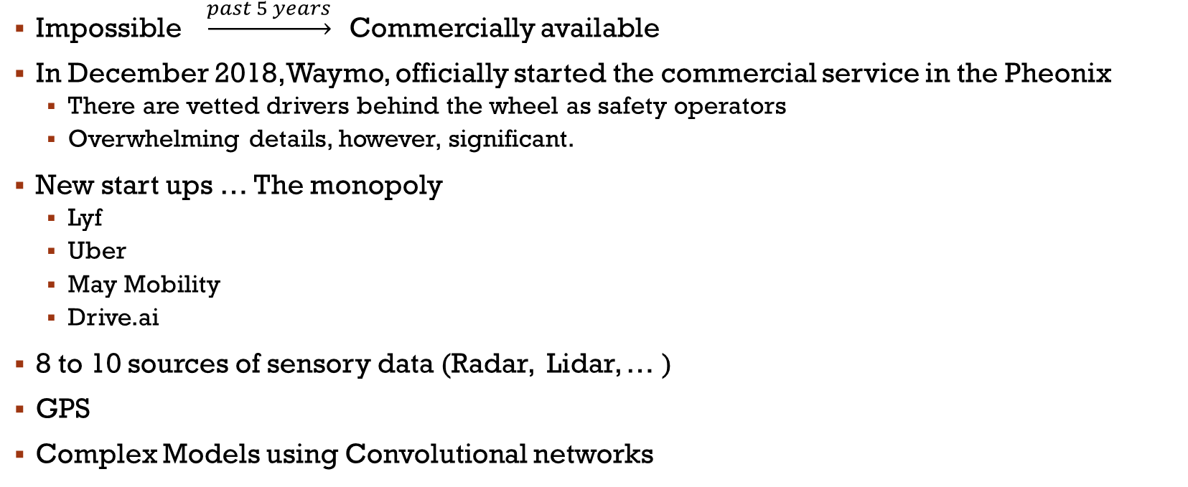
Overview of self driving cars
Impossible $\underset{→}{past 5 years}$Commercially available
In December 2018, Waymo, officially started the commercial service in the Pheonix
There are vetted drivers behind the wheel as safety operators
Overwhelming details, however, significant.
New start ups … The monopoly
Lyf
Uber
May Mobility
Drive.ai
8 to 10 sources of sensory data (Radar, Lidar, … )
GPS
Complex Models using Convolutional networks

Slide 4
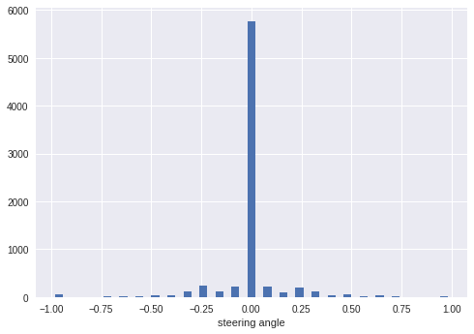
Data acquirement
Simluation Engines: Microsoft, Udacity, etc.
Simple environment to both train and test the model
Captures 3 images per frame from 3 different cameras looking at different angles
We used only the centre images to predict the steering angle
We had a pool of 7458 number of images to work with
Divided into a ratio of 80/20 training/test data.
Distribution of data:
Center | Left | Right | Steering | Throttle | Speed
Address | Address | Adress | 0.3 | 1 | 9.23

Slide 5
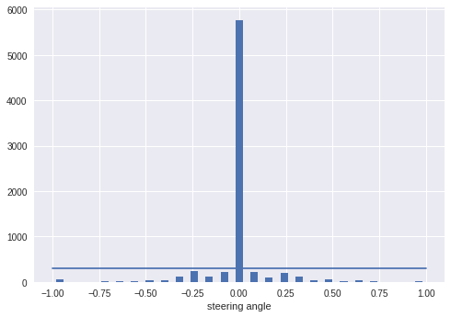
Preprocessing
Bias in the data:
Define a threshold for number of data in each bin:
Crop the images to focus
The color of the sky does not make much change
Change the color channel from RGB to YUV
Nvidia model yields better results
Reduces the noise and smoothen the image
Added a Gaussian blur filter of size 3*3
Resize images to 66*200
Nvidia model has been trained on images of this size
Normalize the data

Slide 6
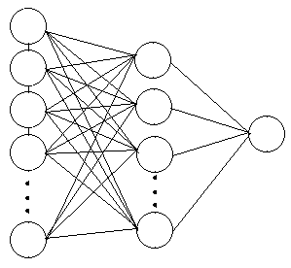
Model structure
Convolutional filters
Capture high level spatial information
Dense Layer
Fully connected
Adjust weights using gradient descent
Activation functions
Predict none-linear complicated functions
Similar to brain neurons firing up
Dropout layer:
Prevent overfitting
Helps in generalization

Slide 7
Model structure
Nividia model works with acceptable accuracy on graphical data:
5 convolutional layers
24*5*5
36*5*5
45*5*5
64*3*3
64*3*3
Dense layers
100-50-10-1 nodes respectively
Model summary:
252, 219 parameters to be learned

Slide 8
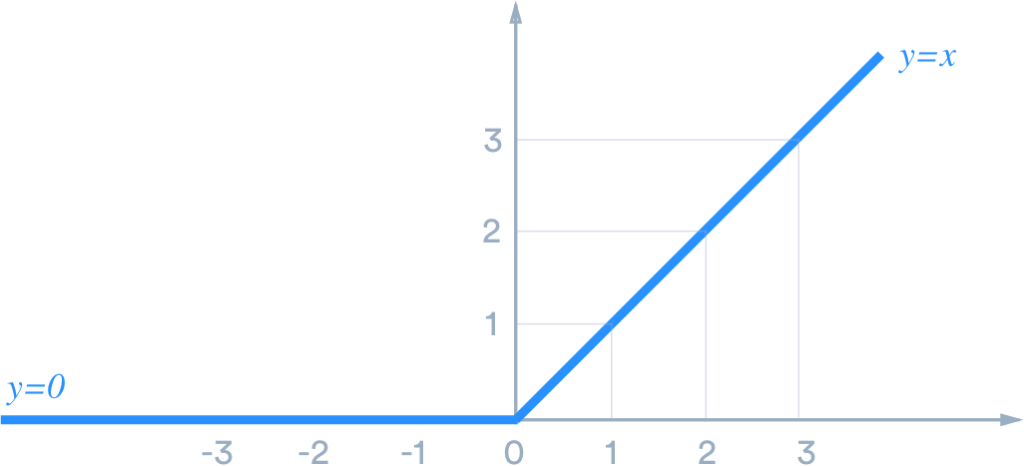
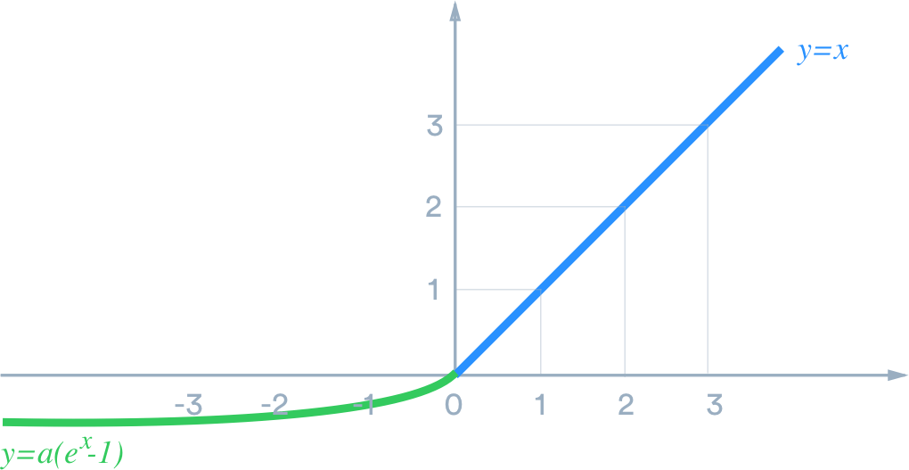
Network structure-challenges
Activation function:
Relu vs elu

Slide 9
Network structure-challenges
Lack of data
Augment data set
Flipped images
Zoomed images
Random brightness images
Transferred or panned images
Too much data for RAM
Add a batch generator to augment, preprocess and feed to network in batches
Over-fitting
Add dropout layers after each fully connected layer to turn off a portion of nodes
Find the optimum value for hyper parameters:
Learning rate
Ratio of dropouts
Number of epochs
Number of data in each batch

Slide 10
Network structure-final parameters
Learning rate
0.0001
Ratio of dropouts
0.0 – 0.0 – 0.2
Number of epochs
33
Number of data in each batch
Training data = 300*100 per batch
Validation data = 200*100 per batch

Slide 11
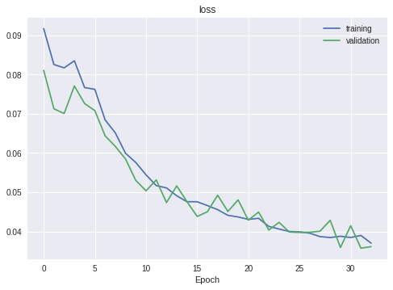

Results
Took 95 mins on the GPU provided by the google colab environment
Loss figures:
Final values: $\left\{\begin{aligned}training loss=0.0371 \\ validation loss=0.0362\end{aligned}\right.$

Slide 12
Demo

Slide 13
Thanks f0r your attention
Happy to receive your questions

